Slide 1


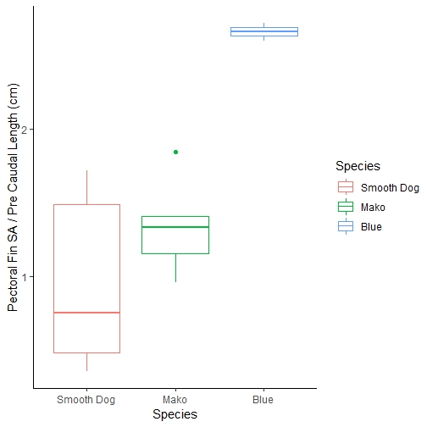
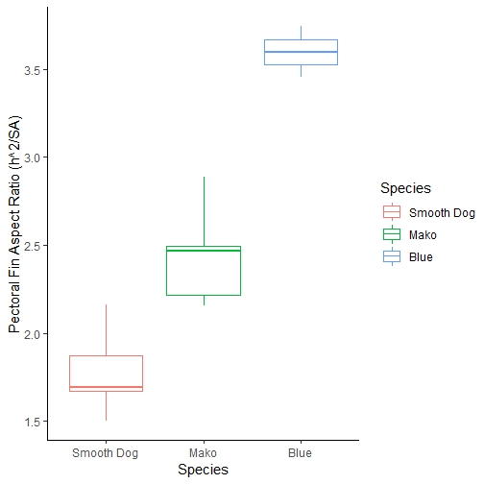
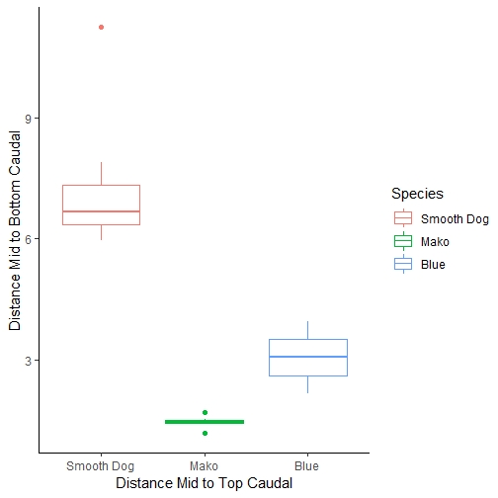
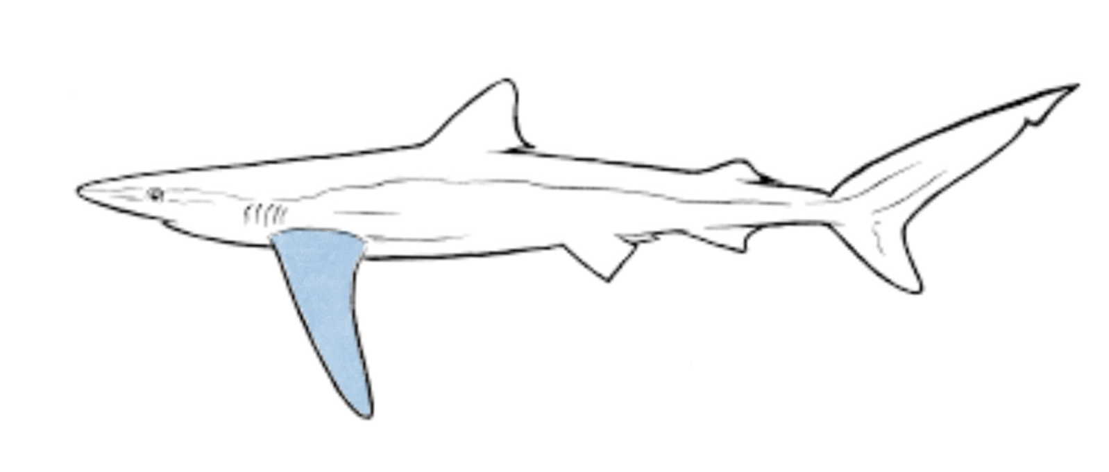
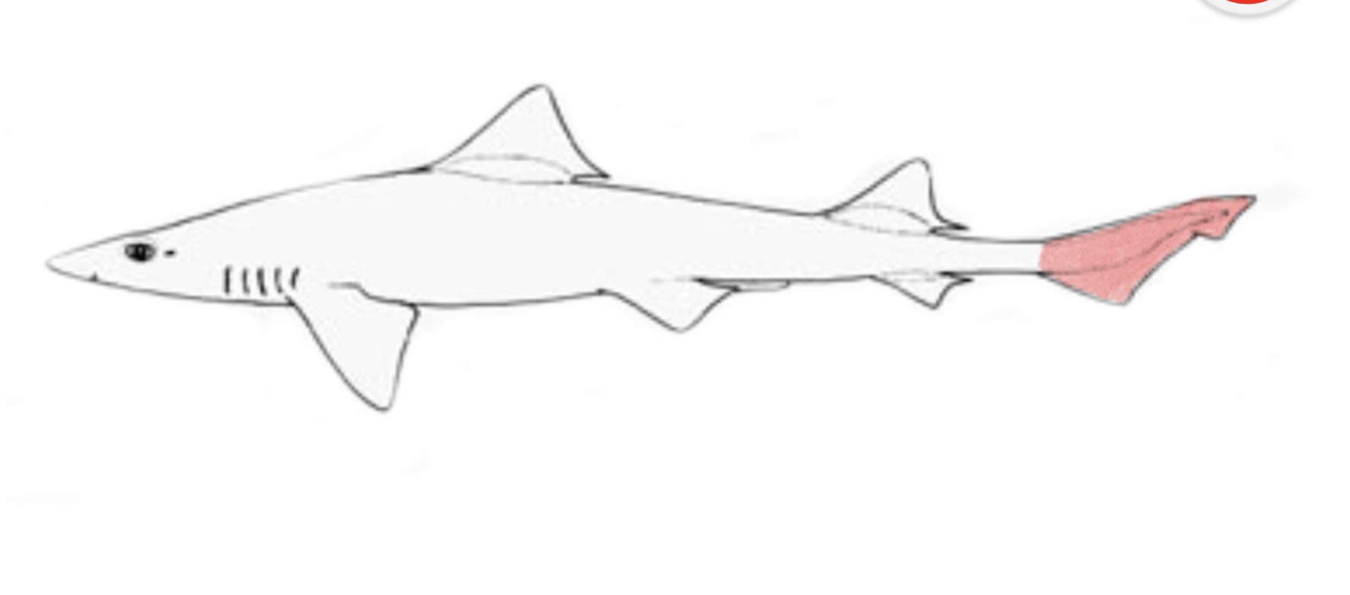
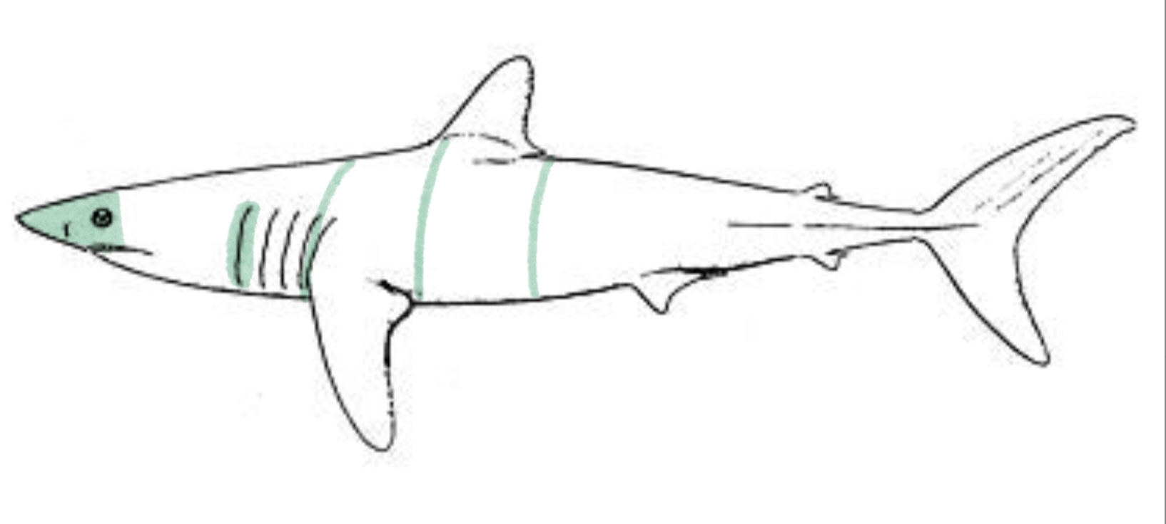
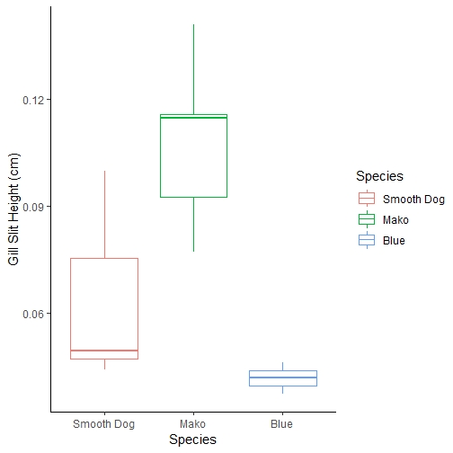
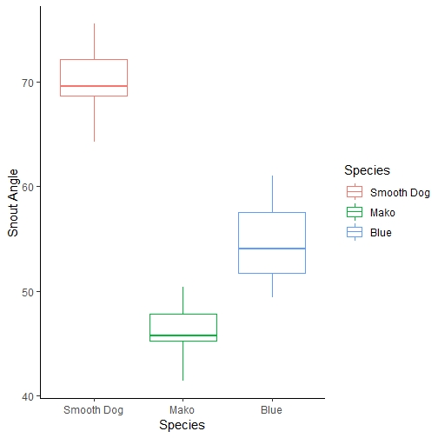
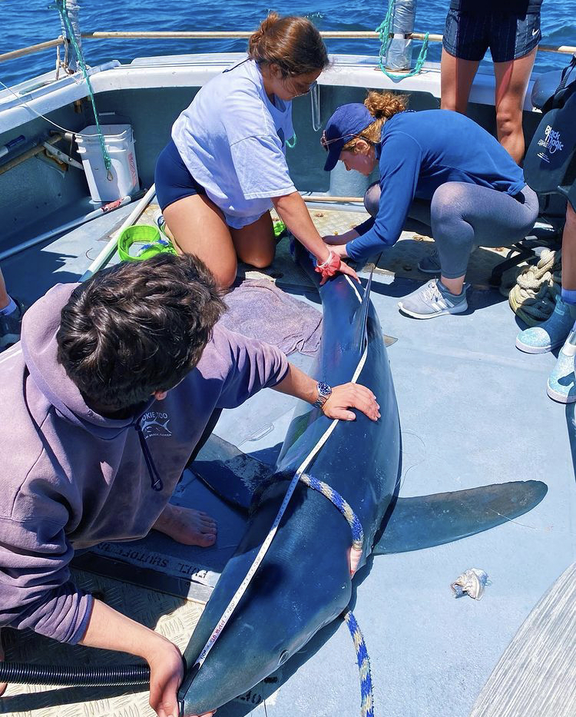
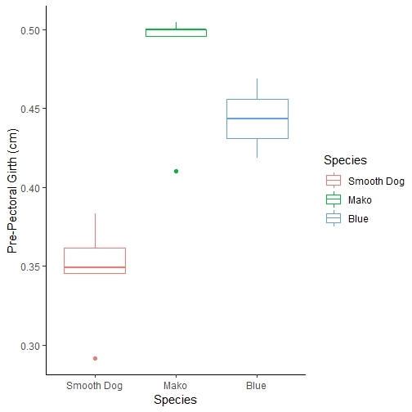
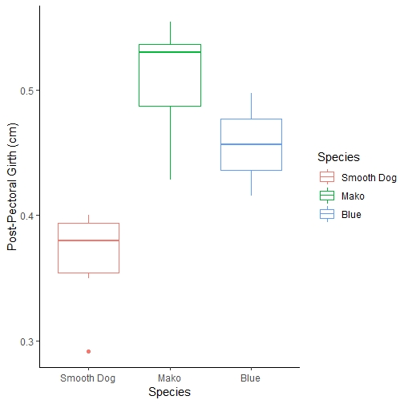
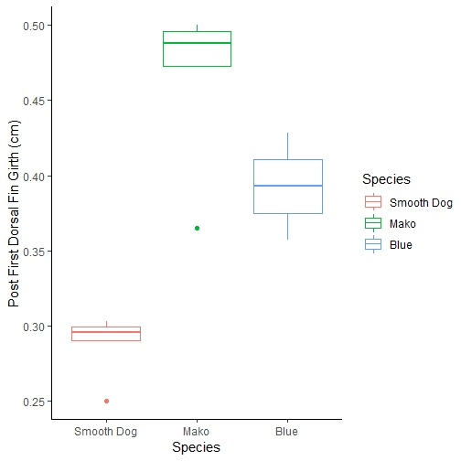
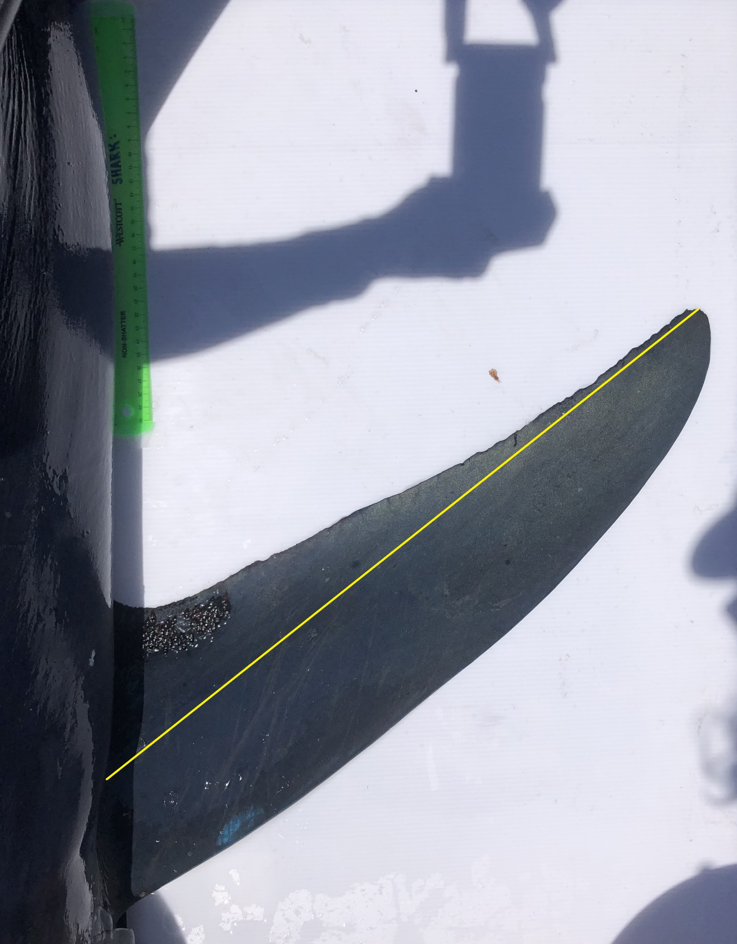
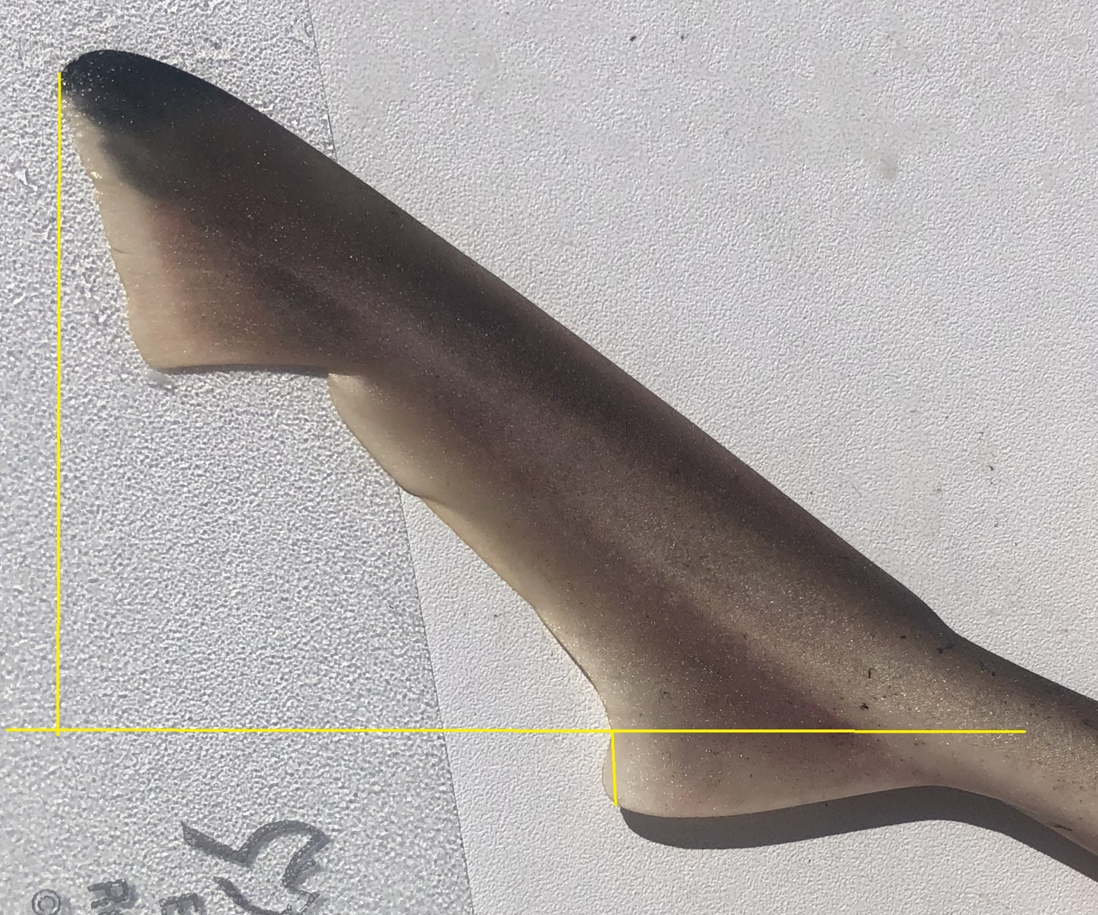
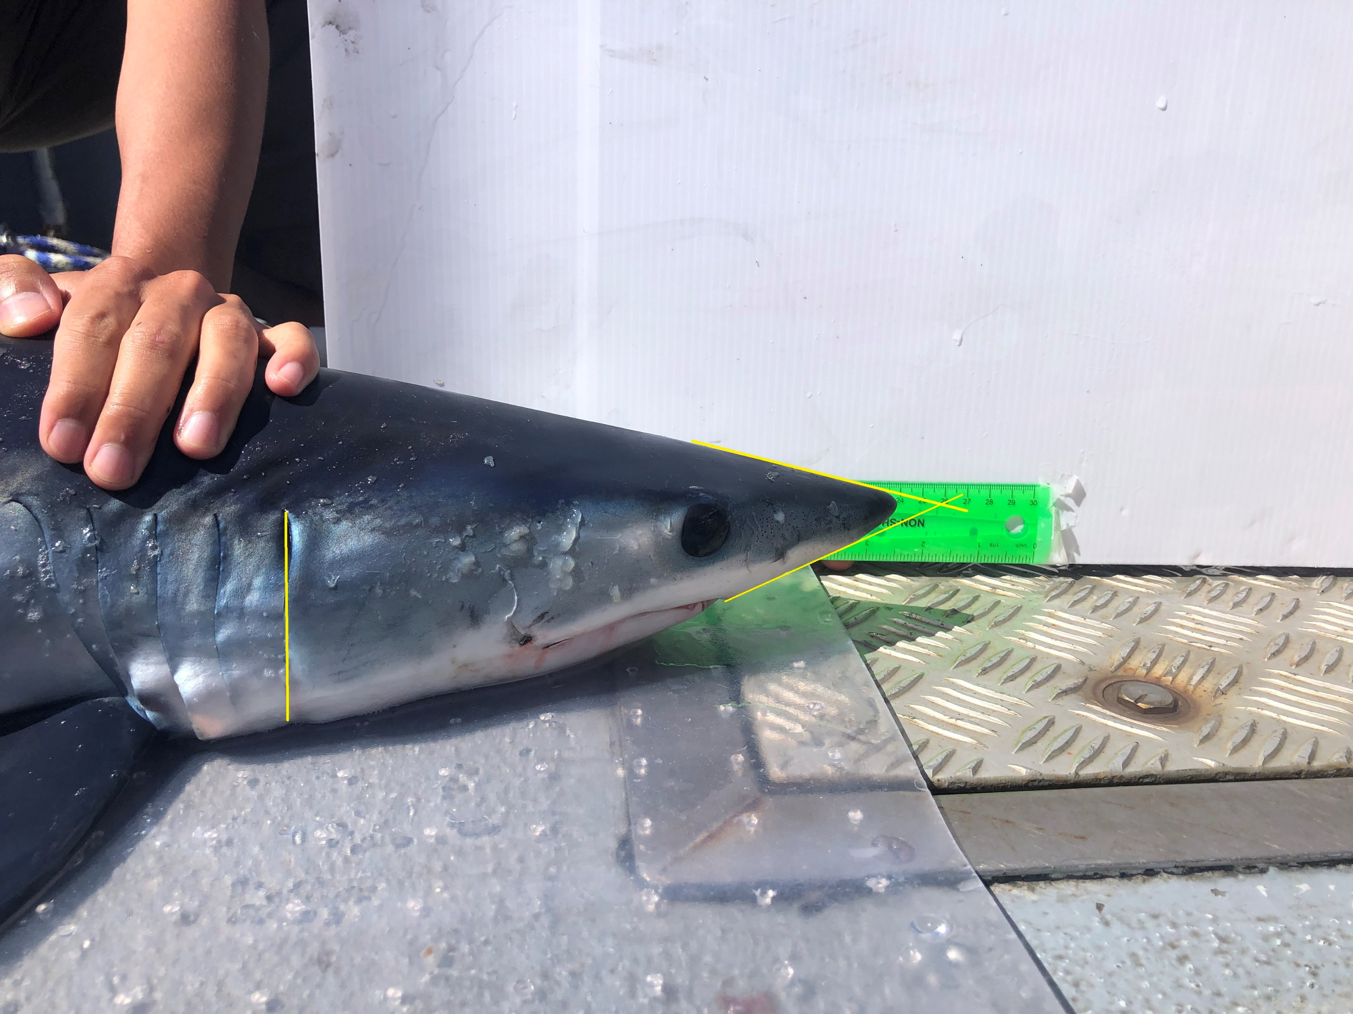
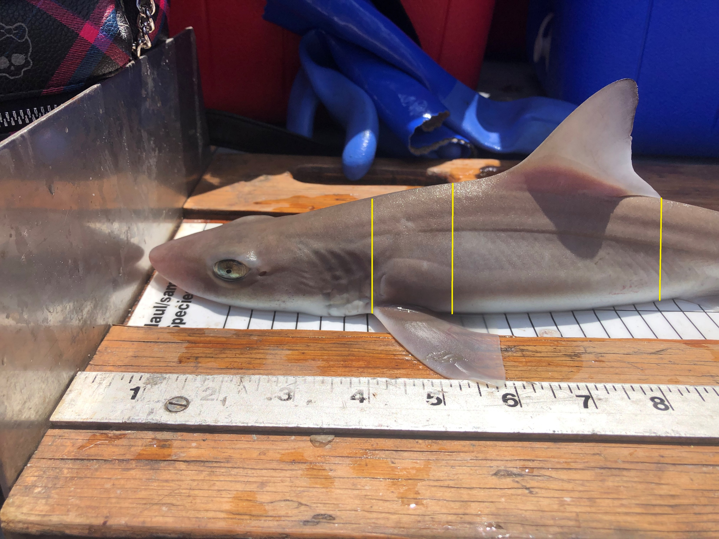
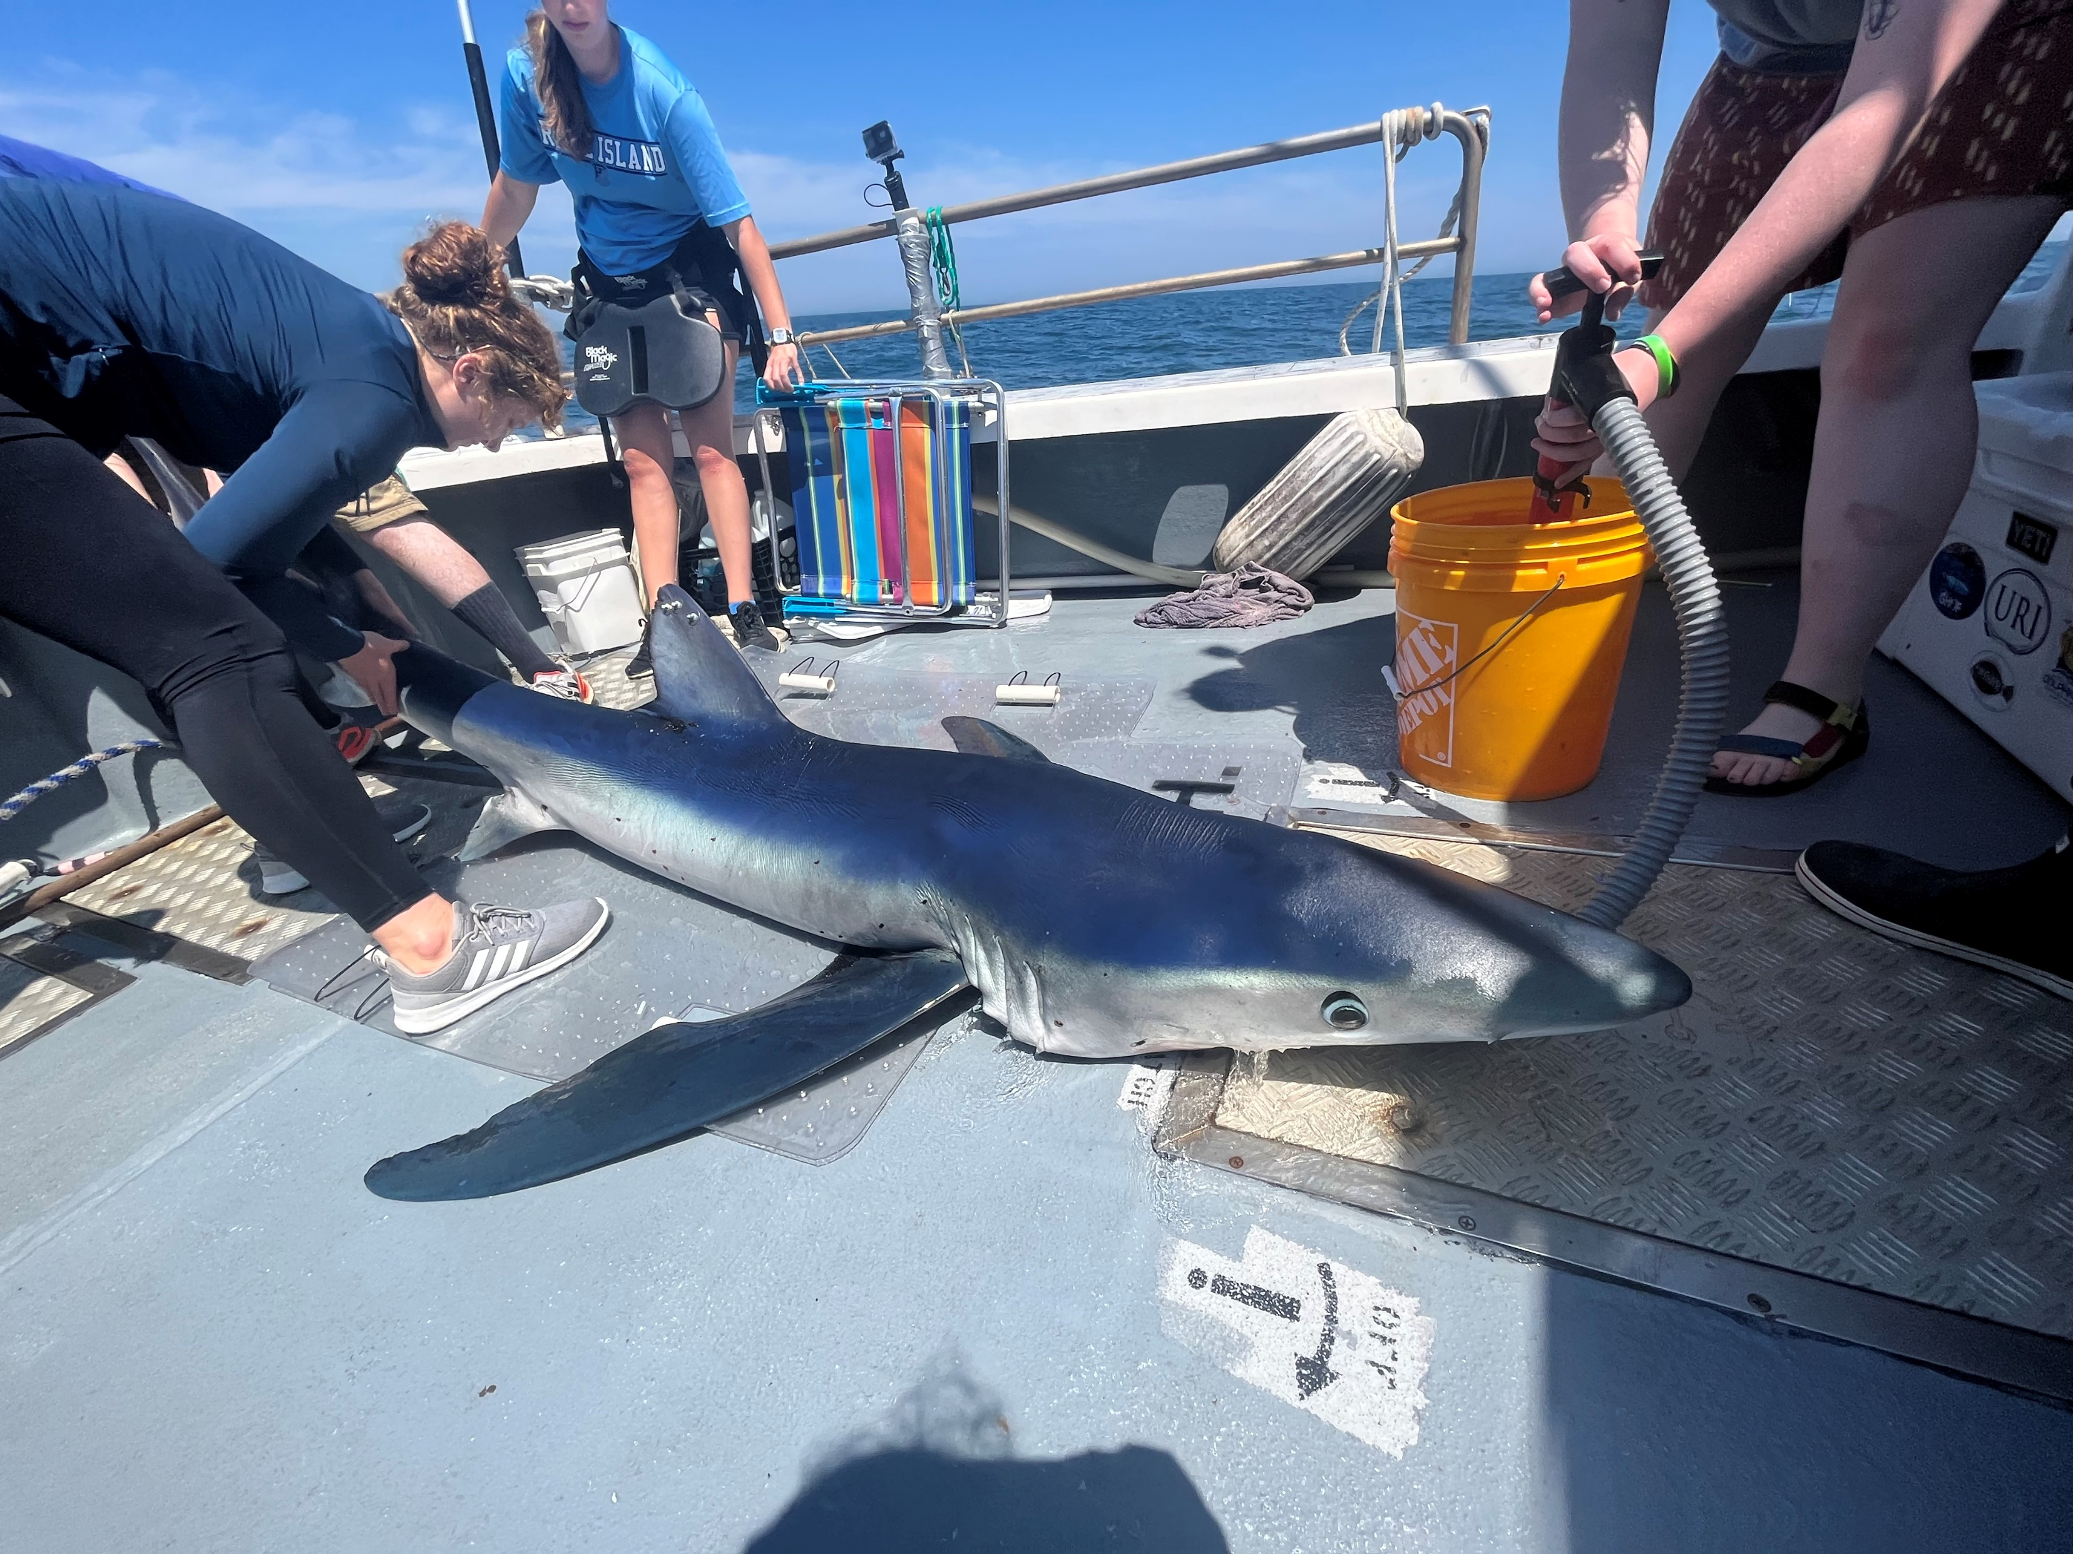
Relationships Between Morphology and Ecology of Three Atlantic Shark Species
Willow Dunster, Dr. Bradley Wetherbee
College of Environmental and Life Sciences, University of Rhode Island, 45 Upper College Rd, Kingston, RI 02881
Introduction
Hydro–Dynamic Lift
Burst Speed
Discussion
Relationships between form and function are well documented in biology. As seen in most animals, morphology varies drastically across shark species and is expected to reflect the subsequent variations in ecology across species. For example, the morphology of body parts and overall shape greatly influences the efficiency with which sharks move through the water, ultimately defining their ecological niche. Rhode Island waters are home to a variety of species of sharks ranging from a sluggish, bottom-oriented species (dusky smooth hound, Mustelus canis), to a slow and continuously swimming pelagic shark (blue shark, Prionace glauca), and the fastest shark in the ocean (shortfin mako shark, Isurus oxyrinchus). In this study, we examined the relationships between morphology and ecology in these three species of sharks that occupy very different niches, by examining the morphological features associated with movement through the water. We hypothesized that morphological features related to drag reduction, hydrodynamic lift, and burst speed will differ among species and reflect their distinct ecological niche.
Figure 11. Blue sharks displayed larger pectoral fin SA and AR likely related to hydrodynamic lift.
Figure 12. Dusky smooth hounds displayed a larger dorsal caudal lobe compared to ventral caudal lobe resulting in easier burst speed.
Figure 13. Shortfin makos displayed a larger gill slit height and girth, and a smaller snout angle, leading to a more hydrodynamic body plan.
Methods
Figure 5. Pectoral fin surface area standardized to pre-caudal length. Blue sharks exhibited larger fin surface areas than makos and dusky smooth hounds (p = 0.054; p = 0.043)
Figure 6. Pectoral fin aspect ratio (width^2/surface area) across species. Blue sharks exhibited longer fins, resulting in a higher aspect ratio. Both blue and mako shark aspect ratios were significantly larger than dusky smooth hounds (p = 0.02, 0.04).
Figure 7. Distance from the tip of the upper caudal lobe to the midpoint compared to the distance between the tip of the lower caudal lobe and the mid point. Dusky smooth hounds had a significantly larger difference in upper and lower lobe size than Mako sharks (p = 0.002).
The results supported our hypothesis that morphological features related to drag reduction, hydrodynamic lift, and burst speed differ among species reflective of their different ecological niches.
Hydrodynamic Lift:
Blue sharks exhibited the largest pectoral fin surface area (SA) and pectoral fin aspect ratio (AR) across all three species. Both features are related to the production of hydrodynamic lift as a large AR and SA indicate a larger lifting surface. This difference is likely related to blue sharks slow, constant swimming in oceanic waters, where hydrodynamic lift generated by large pectoral fins is advantageous⁷ (Figure 11).
Burst Speed:
Caudal fin symmetry was greater in dusky smooth hounds compared to the other two species. This difference is likely related to the demersal lifestyle of smooth hounds and their feeding behavior which includes rapid forward thrust. This movement requires a different tail than constant cruising sharks (blue and mako) ^{8&9} (Figure 12.).
Aerobic Capacity and Drag Reduction:
Gill slit height was statistically greater in makos compared to blue sharks. A larger gill slit height allows for more water to flow across the gills, resulting in a greater amount of oxygen extracted from the water⁵. This is likely related to supporting the higher level of activity in makos compared to the sustained cruising in blue sharks (Figure 13).
Makos exhibited the smallest snout angle across all three species. This difference is likely related to increased drag reduction associated with a conical snout that would support a highly active and oceanic swimming lifestyle¹⁰ (Figure 13).
Makos exhibited the largest body girth across all three species. This difference is likely related to decreased drag associated with a fusiform body shape to support a highly active lifestyle⁶.
Future extensions include increasing the sample size and number of species accessed (Figure 13).
Mako and blue sharks were captured using rod and reel aboard the R/V Hope F Hudner and dusky smoothhounds were captured by otter trawl aboard the R/V Cap’n Bert. Sharks were brought on board and pre-caudal length (PCL) was measured to the nearest 0.5 cm. A series of measurements were recorded using a vinyl tape measure and photos (head, pectoral fins, and tail) were taken with a whiteboard and metric ruler for scaling purposes as the background. Photos of the head, pectoral fins, and tail were analyzed using Image J to estimate a variety of measurements associated with the following specific hydrodynamic characteristics. Box plots were generated in RStudio. A nonparametric Kruskal-Wallace test was performed to test for statistically significant differences in means. A Dunn posthoc test was performed to analyze the statistical relationships between variables
Hydrodynamic Lift:
Pectoral find surface area (SA) – Image J Want Auto Measure tool and Line tool (Figure 1.)
Pectoral fin aspect ratio (AR) – fin length (body to tip) squared, divided by SA of the fin (Figure 1.)
Burst Speed:
Caudal fin symmetry – Image J Line tool to measure the distance from the tip of the upper lobe to the middle of the caudal fin and dividing by the distance from the tip of the lower lobe to the midpoint (Figure 2.)
Aerobic Capacity and Drag Reduction:
Gill slit height – Image J Line tool (Figure 3.)
Snout angle – Image J Line tool and Angle Auto Measure tool from lines drawn from the middle of the eye to the beginning of the mouth (Figure 3.)
Body girth – Vinyl tape measure for girth at pre-pectoral, post-pectoral, and post-first dorsal fin (Figure 4.)
Aerobic Capacity and Drag Reduction
Figure 8. Gill slit height as a proportion of pre-caudal length compared across species. Mako sharks had significantly longer gill slits compared to blue sharks (p = 0.030)
Figure 9. Snout angle measured from mid-eye to mouth as a measure of how conical the snout is. Mako shark snout angle was significantly smaller than Smooth Dog fish (p = .001)
Acknowledgments
Figure 1. Pectoral fin SA and AR
Figure 2. Tail symmetry
We would like to acknowledge the Coastal and Environmental Fellows program for funding this project and Sarah Puckett for her guidance in science communication. A special thanks to the Wetherbee Lab graduate students Colby Kresge, Daniel Daye, and Julian Garrison as well as all the volunteers for assisting with fieldwork, and Garry Dunster for keeping things interesting on the boat.
References
Figure 10. Girth at pre and post pectoral fin and post-first dorsal fin locations as a measure of streamline body shape. Mako shark girth was significantly larger than Smooth Dogfish girth across all three measures (p = 0.008, 0.0.008, 0.006)
¹Bigman et al. 2018. J Morphol ²Mejuto et al. 2008. Collect Vol Sci Pap. ICCAT. 3Bernal et al 2003. J Exp Biol. ⁴Wegner et al. 2010. J Morphol. ⁵ VanderWright et al. 2020. Conserv Physiol. ⁶Donley et al. 2004. Nature. ⁷Bridge et al. 2016. Proc Biol Sci. ⁸Lauder. 2002. J Exp Biol. ⁹Thomson.1976. Paleobiology. ¹⁰Fu. 2016. J Morphol.
Figure 3. Snout angle & gill slit height
Figure 4. Girth measurements

